Slide 1
Object Oriented Development
Week 2 – Programming

Slide 2
Lecture 2 Learning Outcomes
Encapsulation
Representation of a class
Accessor/Mutator methods
Code Mapping
Constructors
Object Construction

Slide 3
Encapsulation
Class is the unit of encapsulation
How to hide the data?
Data
Behaviors
Access Modifier

Slide 4
Accessor and Mutator Methods
New values
Hidden Data
Retrieve values
Getters
Setters
Note the use of ‘this’ keyword

Slide 5
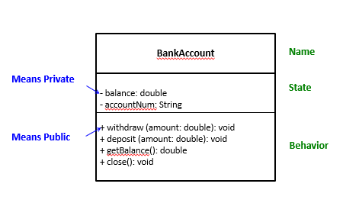
Representation of a class

Slide 6
Code Mapping
public class BankAccount{
private String accountNum;
private double balance;
public void setAccountNum(String accountNum){
this.accountNum = accountNum;
}
public void setBalance(double balance){
this.balance = balance;
}
public String getAccountNum(){
return this.accountNum;
}
public double getBalance(){
return this.balance;
}
public void withdraw(double amount){
this.balance = this.balance – amount;
}
public void deposit(double amount){
this.balance = this.balance + amount;
}
}

Slide 7
Constructor
A method
Has the same name as the class name
No return type
Can be called once per instance during instantiation
Initializes the instance variables

Slide 8
Object Construction
Person p = new Person()
1. Create Reference
2. Object Construction
3. Assignment

Slide 9
Next
Use of static
Instance, class and local variables
Pre-defined classes
The String class
The Math class

